Slide 1
Theme: 'No private commuting at Greater Birba field location' |  | Prepared by: Hamood Said Hinai OSSR Zeyana Saud Said Kindi OSGO1R
The issue of individuals using privately owned vehicles to commute to work (in the interior) has always been a concern to the company due to a spate of horrific Road Traffic Accidents (RTAs) associated with unauthorized private journeys over the years. However, with all great efforts to discourage the use of private vehicles in the interior through many campaigns, the practice persists; involving a rollover historical incident occurred in previous years because of an unauthorized private journey.
Realized Benefits:
Zero and free private commuting in GB in PDO staff and aiming to reach free privately owned vehicles with the contractors as well.
A recent outcome survey of private vehicles in (GB & RHIP) alarming numbers as showed in previous graphs. This indicates that we in GB & RHIP have improved a lot and enhance awareness of avoidance utilization an unauthorized private journey with consequences.
Realized Value
Business Case
We have started with a survey conducted begging of March 2024 in Q1 and recent outcome survey of private vehicles in (GB & RHIP) alarming numbers as showed by below graph. This indicates that we in GB & RHIP have improved a lot and enhance awareness of avoidance utilization an unauthorized private journey with consequences that has been clear with all great efforts done by RHIP and GB HSE Team, GB & RHIP management and RSST Team.
Summarizing what are we doing about Private Commuting differently in GB &RHIP to be sustained,
Discouraging clear message to everyone
Strongly discouraging the use of Private Vehicles to commute to interior work locations especially staff from Salalah area or nearby region.
Educations & convincing staff
Educating and convincing our staff to utilize PDO approved public transport (Heavy Buses) example staff from Salalah area. Approved public transport companies and corresponding buses are posted on the logistics website.
Assurance of Contractors Compliance with SP2000
Ensuring that our Contractors provide comfortable and SP2000 compliant bus operation for their staff.
Discuss the issue during HSE meetings and just before the shift change.
Sustaining Awareness in different form
Build Journey of No Privately owned vehicles GB area

Slide 2
Recognized and rewarded the top 11 drivers in GB with gifts and certificates for their great behavior

Slide 3
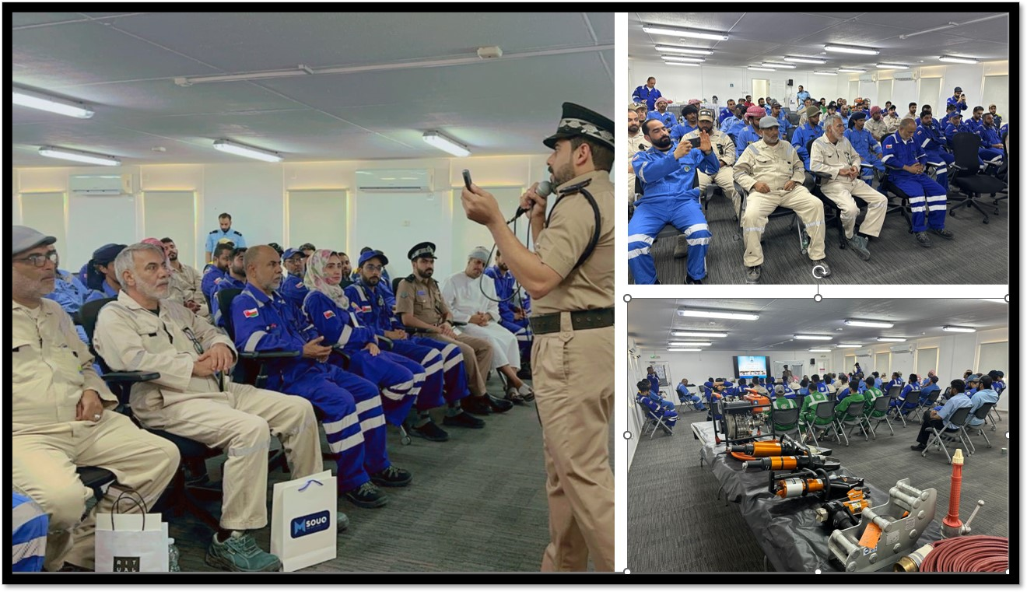
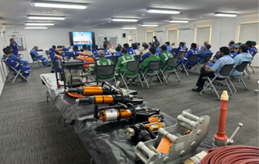
An awareness session from ROP on road safety

Slide 4
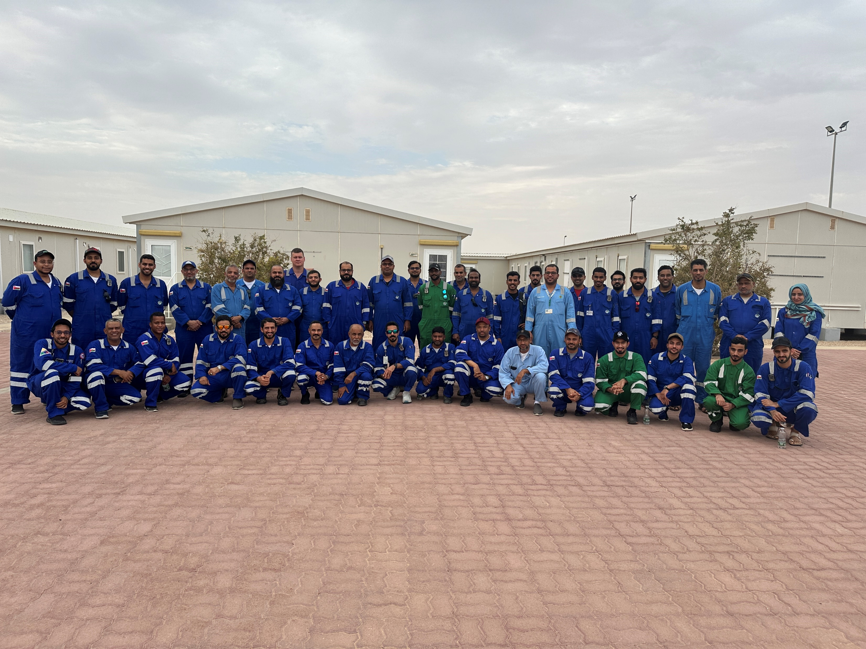
GB & RHIP team

